Slide 1




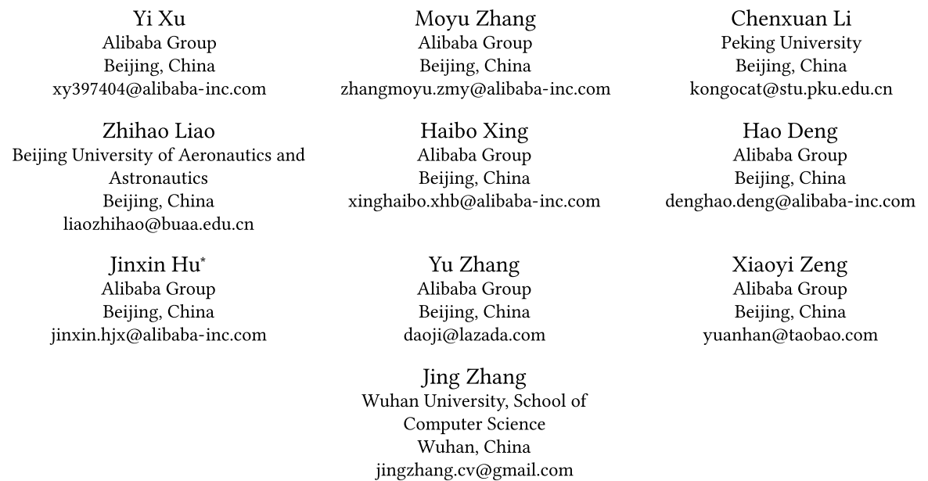





ATAI
Advanced Technique of Artificial Intelligence
ATAI
ChongqingUniversity _{AdvancedTechniqueof}
of Technology Artificial Intelligence
Chongqing University of
Technology
Chongqing University ^{ATAI}
_{of Technology} Advanced Techniqueof
Artificial Intelligence
Chongqing University of Technology
Chongqing University of Technology
MMQ: Multimodal Mixture-of-Quantization Tokenization for Semantic ID Generation and User Behavioral Adaptation
Code : None
—— WSDM’2026
2026.3.10. • ChongQing
Reported by YaoYao Zhang
1

Slide 2
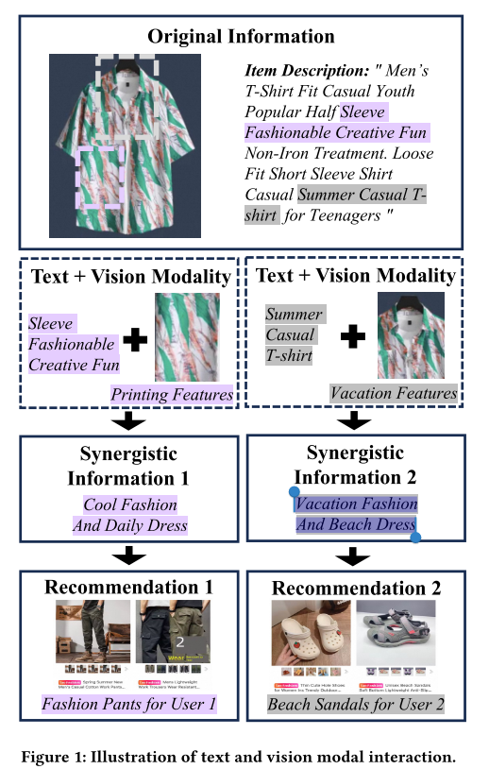
ATAI
Advanced Technique of Artificial Intelligence
ATAI
ChongqingUniversity _{AdvancedTechniqueof}
of Technology Artificial Intelligence
Chongqing University of
Technology
Chongqing University ^{ATAI}
_{of Technology} Advanced Techniqueof
Artificial Intelligence
Motivation
Chongqing University of Technology
Chongqing University of Technology
i)The existing multimodal semantic tokens have the following problems: one must either capture synergy at the risk of losing uniqueness , or preserve uniqueness at the cost of ignoring synergy.
2)Traditional two-stage semantic ID recommendation frameworks suffer from a semantic-behavior gap, where the semantic space learned by the tokenizer is misaligned with downstream user behavior objectives, and the discrete quantization process blocks gradient backpropagation, making end-to-end alignment difficult.
Notes:
单一模态只能提供商品的局部语义，而跨模态交互能够揭示更细粒度的风格属性与用户偏好指向。这种协同效应与模态独特的细节结合，能够提供更精确的推荐
传统先训练一个item tokenizer再把内容映射为语义id，在拿这些id去下游进行推荐的行为会导致梯度不回传tokenizer，无法动态适应下游任务。造成 tokenizer 的语义空间和下游行为目标之间的根本失配。

Slide 3
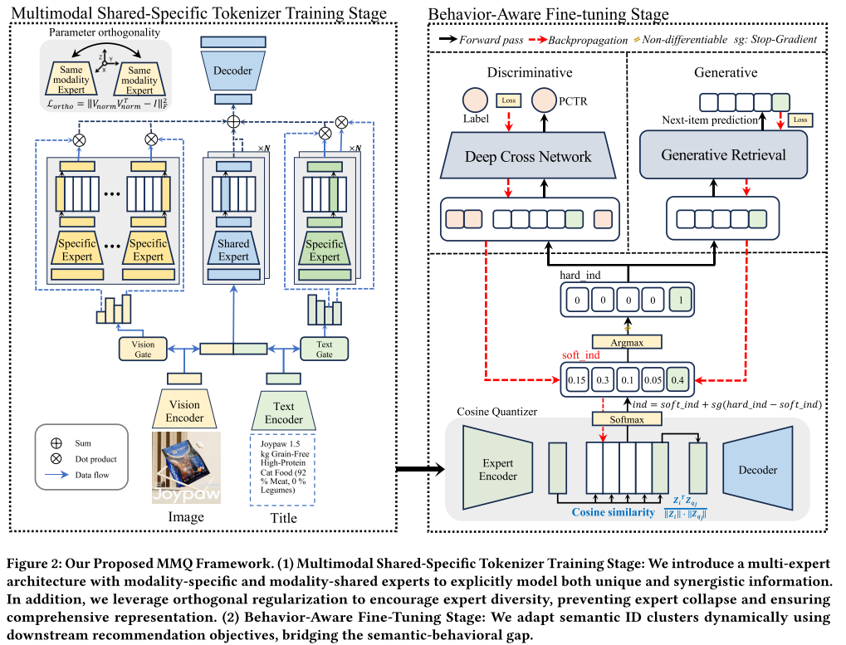
ATAI
Advanced Technique of Artificial Intelligence
ATAI
ChongqingUniversity _{AdvancedTechniqueof}
of Technology Artificial Intelligence
Chongqing University of
Technology
Chongqing University ^{ATAI}
_{of Technology} Advanced Techniqueof
Artificial Intelligence
Chongqing University of Technology
Chongqing University of Technology
Notes:
1、拼接后的跨模态输入进入 shared experts，单模态输入分别进入各自的 specific experts，从而分别建模协同信息和模态特有信息。
gate是用来融合表示的，不是像MOE那样选择性的激活专家。
2、在标准 VQ-VAE 里，码本通常一开始就是随机初始化的。
3、受索引反向传播量化实现离散码本的梯度回传。

Slide 4
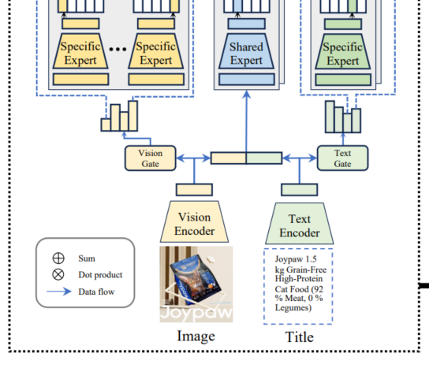


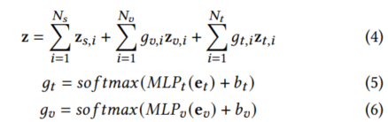
ATAI
Advanced Technique of Artificial Intelligence
ATAI
ChongqingUniversity _{AdvancedTechniqueof}
of Technology Artificial Intelligence
Chongqing University of
Technology
Chongqing University ^{ATAI}
_{of Technology} Advanced Techniqueof
Artificial Intelligence
Chongqing University of Technology
Chongqing University of Technology

Slide 5

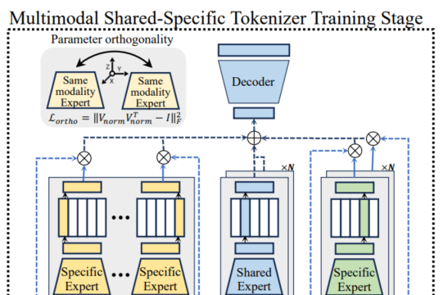


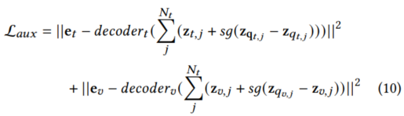
ATAI
Advanced Technique of Artificial Intelligence
ATAI
ChongqingUniversity _{AdvancedTechniqueof}
of Technology Artificial Intelligence
Chongqing University of
Technology
Chongqing University ^{ATAI}
_{of Technology} Advanced Techniqueof
Artificial Intelligence
Chongqing University of Technology
Chongqing University of Technology
Method

Slide 6

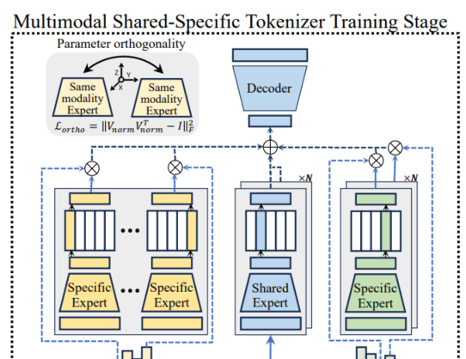


ATAI
Advanced Technique of Artificial Intelligence
ATAI
ChongqingUniversity _{AdvancedTechniqueof}
of Technology Artificial Intelligence
Chongqing University of
Technology
Chongqing University ^{ATAI}
_{of Technology} Advanced Techniqueof
Artificial Intelligence
Method
Chongqing University of Technology
Chongqing University of Technology

Slide 7
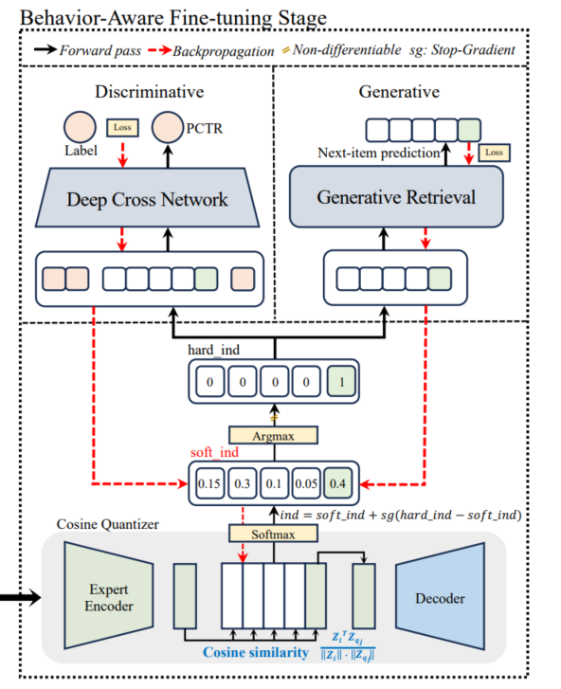

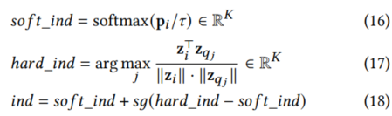
ATAI
Advanced Technique of Artificial Intelligence
ATAI
ChongqingUniversity _{AdvancedTechniqueof}
of Technology Artificial Intelligence
Chongqing University of
Technology
Chongqing University ^{ATAI}
_{of Technology} Advanced Techniqueof
Artificial Intelligence
Method
Chongqing University of Technology
Chongqing University of Technology

Slide 8
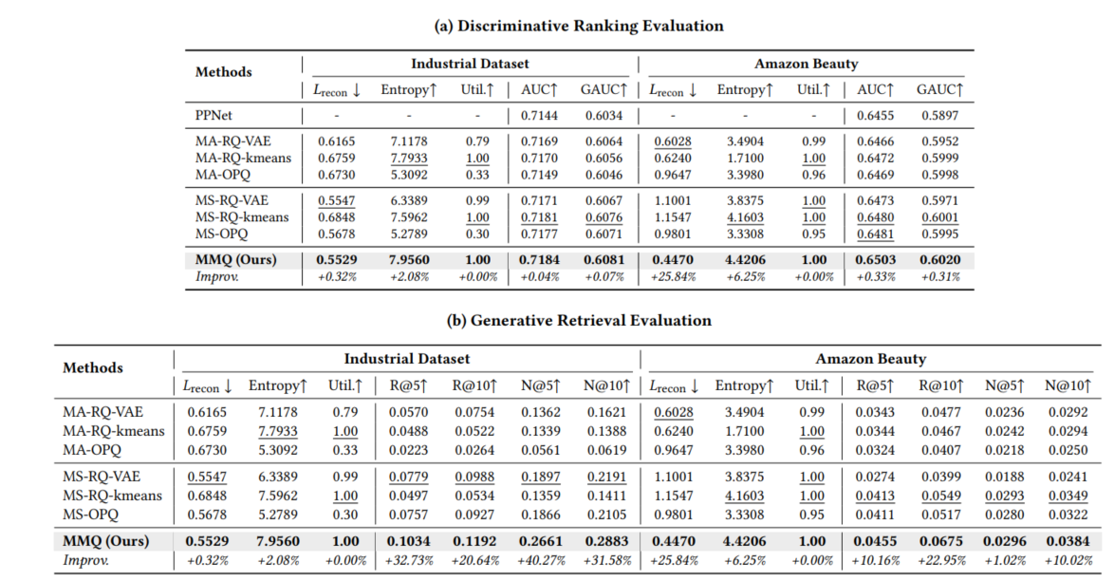
ATAI
Advanced Technique of Artificial Intelligence
ATAI
ChongqingUniversity _{AdvancedTechniqueof}
of Technology Artificial Intelligence
Chongqing University of
Technology
Chongqing University ^{ATAI}
_{of Technology} Advanced Techniqueof
Artificial Intelligence
Method
Chongqing University of Technology
Chongqing University of Technology

Slide 9
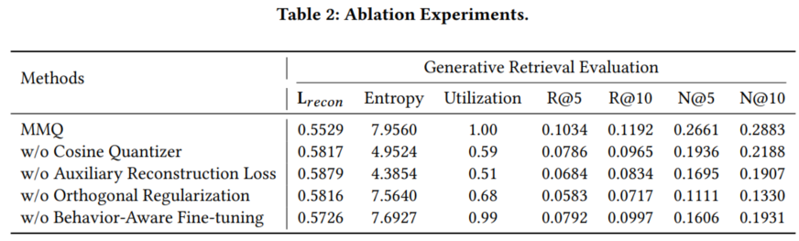
ATAI
Advanced Technique of Artificial Intelligence
ATAI
ChongqingUniversity _{AdvancedTechniqueof}
of Technology Artificial Intelligence
Chongqing University of
Technology
Chongqing University ^{ATAI}
_{of Technology} Advanced Techniqueof
Artificial Intelligence
Method
Chongqing University of Technology
Chongqing University of Technology

Slide 10
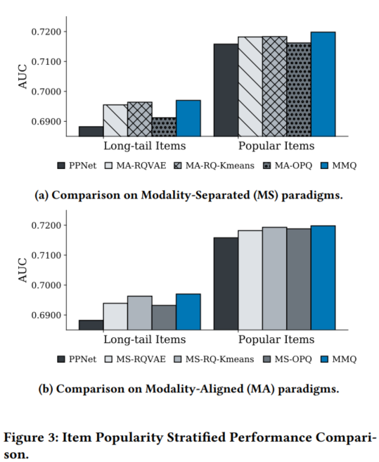
ATAI
Advanced Technique of Artificial Intelligence
ATAI
ChongqingUniversity _{AdvancedTechniqueof}
of Technology Artificial Intelligence
Chongqing University of
Technology
Chongqing University ^{ATAI}
_{of Technology} Advanced Techniqueof
Artificial Intelligence
Method
Chongqing University of Technology
Chongqing University of Technology

Slide 11
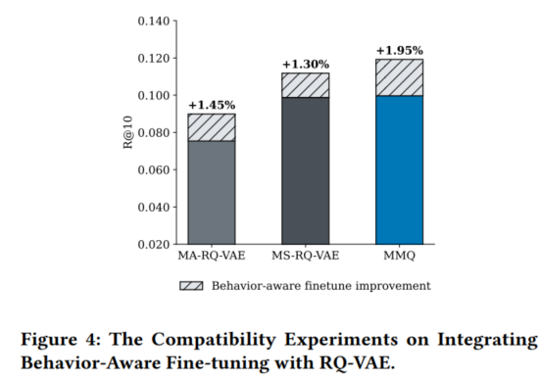
ATAI
Advanced Technique of Artificial Intelligence
ATAI
ChongqingUniversity _{AdvancedTechniqueof}
of Technology Artificial Intelligence
Chongqing University of
Technology
Chongqing University ^{ATAI}
_{of Technology} Advanced Techniqueof
Artificial Intelligence
Method
Chongqing University of Technology
Chongqing University of Technology

Slide 12
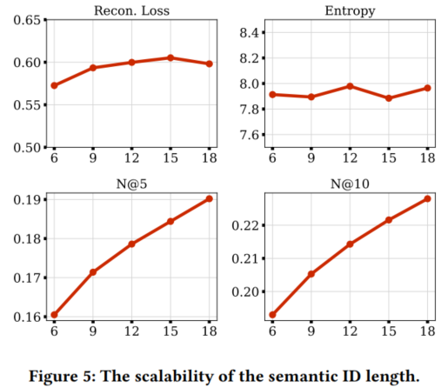
ATAI
Advanced Technique of Artificial Intelligence
ATAI
ChongqingUniversity _{AdvancedTechniqueof}
of Technology Artificial Intelligence
Chongqing University of
Technology
Chongqing University ^{ATAI}
_{of Technology} Advanced Techniqueof
Artificial Intelligence
Method
Chongqing University of Technology
Chongqing University of Technology

Slide 13
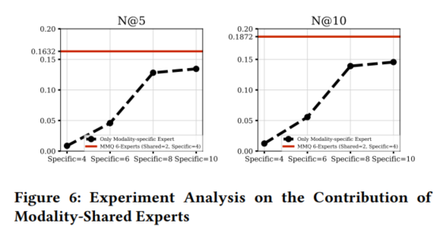
ATAI
Advanced Technique of Artificial Intelligence
ATAI
ChongqingUniversity _{AdvancedTechniqueof}
of Technology Artificial Intelligence
Chongqing University of
Technology
Chongqing University ^{ATAI}
_{of Technology} Advanced Techniqueof
Artificial Intelligence
Method
Chongqing University of Technology
Chongqing University of Technology

Slide 14
ATAI
Advanced Technique of Artificial Intelligence
ATAI
ChongqingUniversity _{AdvancedTechniqueof}
of Technology Artificial Intelligence
Chongqing University of
Technology
Chongqing University ^{ATAI}
_{of Technology} Advanced Techniqueof
Artificial Intelligence
Chongqing University of Technology
Chongqing University of Technology
Thanks!

